Slide 1
The Results section: part 2
Fish 290
Thursday February 6th

Slide 2
Posters are coming up!
Poster session is Thursday Feb. 20^{h} (two weeks from today).
Attendance in class will be mandatory.
Your poster is worth 20% of your final grade
How can you prepare now?
Continue re-reading your chosen paper and get to know it well
Observe the posters from actual studies (see Canvas) and past student posters. What works, what doesn’t?

Slide 3
Presentation of Results:
Three complementary approaches
Today’s agenda:
1. Review of statistics in excel
Reporting results in text
Basics of tables

Slide 4
Let’s detour for a moment to talk about statistics.
What is the purpose of using a statistical test?

Slide 5
Basics of statistics
We collect data to test or “falsify” a null hypothesis
Null hypothesis: Male and female fish are of similar length
Approach: Measure lengths of males and females
Data: Length measurements by sex
Attributes: Mean, standard deviation, sample size
Statistical test: Two-sample t-test
Output: Probability of obtaining the data distribution if the null hypothesis were true

Slide 6
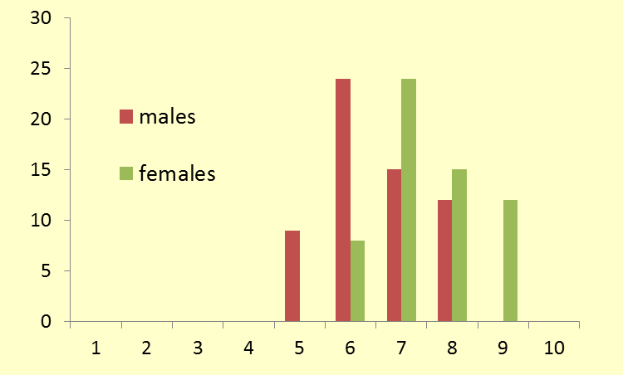
Male mean = 6.5, SD = 0.94, n = 60
Female mean = 7.5, SD = 0.94, n = 60
t = 5.57, df = 118, P < 0.001
Frequency
Length (cm)

Slide 7
How do we read this?
Male mean = 6.5 cm, SD = 0.94, n = 60
Female mean = 7.5 cm, SD = 0.94, n = 60
t = 5.57, df = 118, P < 0.001
SD = standard deviation, a measure of variation around the mean; the bigger the number, the more variation
n = sample size
t = the test statistic, this is calculated from the data and compared to a null distribution
df = degrees of freedom (a function of sample size: (n(males) – 1) + (n(females) -1)
P = the probability of obtaining these data if the null hypothesis were true

Slide 8
What does it mean?
Here we can be confident that the lengths of males and females differ. That is, there is a <0.1% chance that their length distributions were drawn from the same pool.
Remember that this assumes that the fish were collected in a random (non-biased manner), and so the sampling methods are important.
How would our confidence change if the mean values were the same, but the data were more variable?

Slide 9
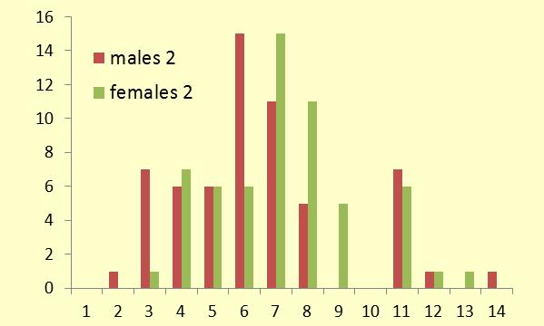
Male mean = 6.5, SD = 2.73, n = 60
Female mean = 7.5, SD = 2.73, n = 60
t = 2.00, df = 118, P = 0.02
Frequency
Length (cm)

Slide 10
In this case we can still be confident that the lengths of males and females differ. The statistical test indicates that there is a <2% chance that their distributions were drawn from the same pool.
Suppose we increase the variation in the data even more but keep the means the same?

Slide 11
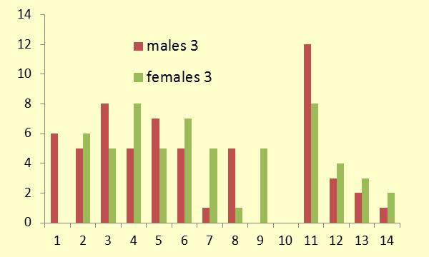
Male mean = 6.5, SD = 4.19, n = 60
Female mean = 7.5, SD = 4.19, n = 60
t = 1.31, df = 118, P = 0.10
Frequency
Length (cm)

Slide 12
Suppose we take the last data set and double the sample size.
Male mean = 6.5, SD = 4.19, n = 60
Female mean = 7.5, SD = 4.19, n = 60
t = 1.31, df = 118, P = 0.10
Male mean = 6.5, SD = 4.19, n = 120
Female mean = 7.5, SD = 4.19, n = 120
t = 1.86, df = 238, P = 0.03

Slide 13
So, our ability to confidently detect a difference when there is one:
Sample size: more is better
Difference between means: bigger is better
Variation: less is better

Slide 14
Thinking about your results...
Is statistical significance the same thing as biological importance?
NO!!!*
Can have a sig. difference, but difference is small and/or biologically trivial
Can have a non-sig. difference with important biological implications
*You have a short reading on this idea this week!

Slide 15
Common types of statistical tests
If you want to… | Use a…
Compare proportions | Chi-squared test
Compare means of two groups | T-test
Compare means of more than two groups | ANOVA
Test dependence of two continuous variables | Linear regression
Lots of other statistical tests exist, but are more complex and beyond the scope of this class

Slide 16
Presentation of Results:
Three complementary approaches
Text: We state in words what we found - what happened.
Figures: Graphs help visualize complex relationships and draw the reader’s attention to the most important findings.
Tables: Provide details on the results that are important
(also supplementary material/appendices)

Slide 17
What is a result?
Raw data: data collected from observations or experiments as described in the Methods
Summary statistics: A number representing a summary of raw data, such as: sample size, mean, median, standard deviation
Patterns: an increase or decrease, larger or smaller, etc.
Results of statistical tests: test statistic, p-value, r² value, etc.
What is reported in the Results section? Usually the latter three items (why not raw data?)

Slide 18
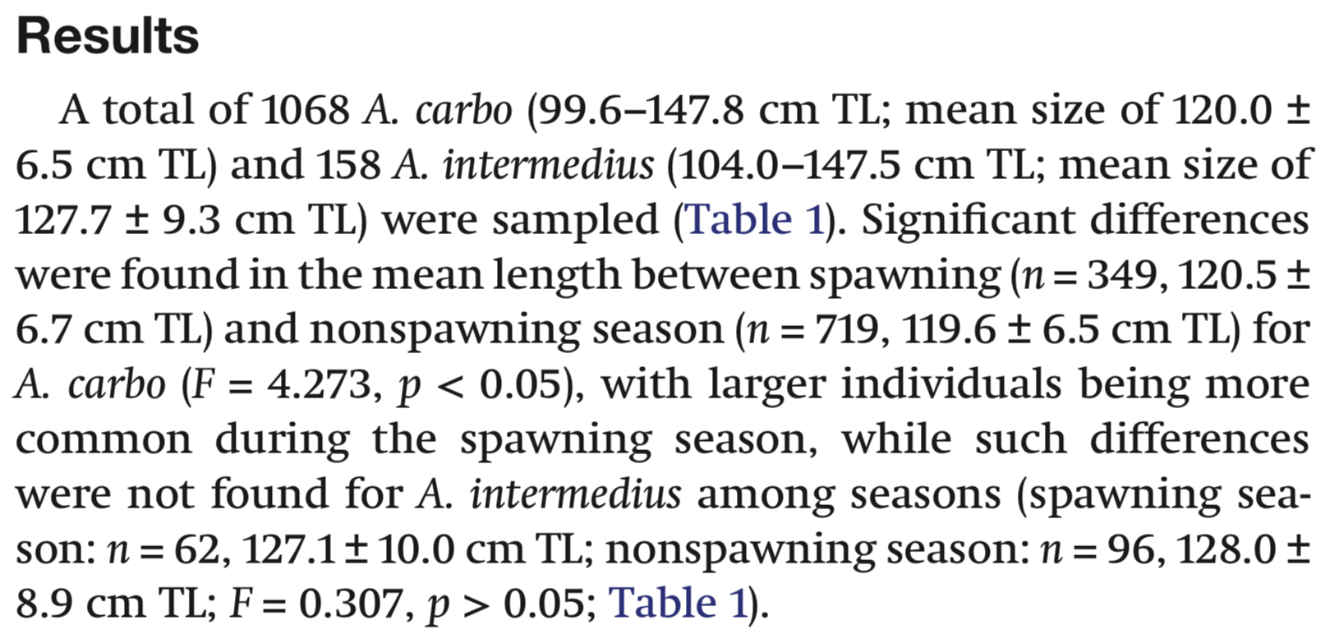
Try to identify:
Raw data
Summary statistics
Patterns
Results of statistical tests

Slide 19
Try to identify:
Raw data
Summary statistics
Patterns
Results of statistical tests

Slide 20
Presentation of Results:
Compare these sentences describing the same result:
The size of seeds is shown in Fig. 1.
We don’t know what the pattern is- text doesn’t stand alone!
Fertilized seeds were larger than unfertilized seeds.
Vague, not credible- needs details to back it up
Fertilized seeds were larger than unfertilized seeds (Fig. 1).
Better, but comes at an opportunity cost- reader needs to find Fig. 1 and break from reading text (e.g. how much larger?)
The mean weight of fertilized seeds was 1.8 g. The mean weight of unfertilized seeds was 0.9 g.
Asking reader to interpret for you- that is your job!!
Fertilized seeds were larger than unfertilized seeds (mean 1.8 vs. 0.9 g, p=0.019; Fig. 1).
Best: gives both the interpretation and the detail needed.

Slide 21
Presentation of Results:
Compare these sentences describing the same result:
The size of seeds is shown in Fig. 1.
We don’t know what the pattern is- text doesn’t stand alone!
Fertilized seeds were larger than unfertilized seeds.
Vague, not credible- needs details to back it up
Fertilized seeds were larger than unfertilized seeds (Fig. 1).
Better, but comes at an opportunity cost- reader needs to find Fig. 1 and break from reading text (e.g. how much larger?)
The mean weight of fertilized seeds was 1.8 g. The mean weight of unfertilized seeds was 0.9 g.
Asking reader to interpret for you- that is your job!!
Fertilized seeds were larger than unfertilized seeds (mean 1.8 vs. 0.9 g, p=0.019; Fig. 1).
Best: gives both the interpretation and the detail needed.

Slide 22
Presentation of Results:
Compare these sentences describing the same result:
The size of seeds is shown in Fig. 1.
We don’t know what the pattern is- text doesn’t stand alone!
Fertilized seeds were larger than unfertilized seeds.
Vague, not credible- needs details to back it up
Fertilized seeds were larger than unfertilized seeds (Fig. 1).
Better, but comes at an opportunity cost- reader needs to find Fig. 1 and break from reading text (e.g. how much larger?)
The mean weight of fertilized seeds was 1.8 g. The mean weight of unfertilized seeds was 0.9 g.
Asking reader to interpret for you- that is your job!!
Fertilized seeds were larger than unfertilized seeds (mean 1.8 vs. 0.9 g, p=0.019; Fig. 1).
Best: gives both the interpretation and the detail needed.

Slide 23
Presentation of Results:
Compare these sentences describing the same result:
The size of seeds is shown in Fig. 1.
We don’t know what the pattern is- text doesn’t stand alone!
Fertilized seeds were larger than unfertilized seeds.
Vague, not credible- needs details to back it up
Fertilized seeds were larger than unfertilized seeds (Fig. 1).
Better, but reader needs to find Fig. 1 and break from reading text (e.g. how much larger?)
The mean weight of fertilized seeds was 1.8 g. The mean weight of unfertilized seeds was 0.9 g.
Asking reader to interpret for you- that is your job!!
Fertilized seeds were larger than unfertilized seeds (mean 1.8 vs. 0.9 g, p=0.019; Fig. 1).
Best: gives both the interpretation and the detail needed.

Slide 24
Presentation of Results:
Compare these sentences describing the same result:
The size of seeds is shown in Fig. 1.
We don’t know what the pattern is- text doesn’t stand alone!
Fertilized seeds were larger than unfertilized seeds.
Vague, not credible- needs details to back it up
Fertilized seeds were larger than unfertilized seeds (Fig. 1).
Better, but reader needs to find Fig. 1 and break from reading text (e.g. how much larger?)
The mean weight of fertilized seeds was 1.8 g. The mean weight of unfertilized seeds was 0.9 g.
Asking reader to interpret for you- that is your job!!
Fertilized seeds were larger than unfertilized seeds (mean 1.8 vs. 0.9 g, p=0.019; Table 3; Fig. 1).
Best: gives both the interpretation and the detail needed.

Slide 25
Presentation of Results:
Compare these sentences describing the same result:
The size of seeds is shown in Fig. 1.
We don’t know what the pattern is- text doesn’t stand alone!
Fertilized seeds were larger than unfertilized seeds.
Vague, not credible- needs details to back it up
Fertilized seeds were larger than unfertilized seeds (Fig. 1).
Better, but comes at an opportunity cost- reader needs to find Fig. 1 and break from reading text (e.g. how much larger?)
The mean weight of fertilized seeds was 1.8 g. The mean weight of unfertilized seeds was 0.9 g.
Asking reader to interpret for you- that is your job!!
Fertilized seeds were larger than unfertilized seeds (mean 1.8 vs. 0.9 g, p=0.019; Table 3; Fig. 1).
Best: gives both the interpretation and the detail needed.

Slide 26
Making effective tables
Tables are appropriate when the precision of a value matters (like a p-value) and you have many variables to display.
Tables are also good for background information (comparing field sites, results from prior literature, or species)
For example:
A list of species used in study and their locations and diets
A list of relevant past studies and their key findings
The results of multiple statistical tests

Slide 27
Making effective tables
We read from left-to-right, so put context-setting information on the left and dependent information on the right.
These tables show the same data. Which is easier to read?
Time (minutes) | Temperature (°C)
0 | 25
3 | 27
6 | 29
9 | 31
12 | 32
15 | 32
Temperature (°C) | Time (minutes)
25 | 0
27 | 3
29 | 6
31 | 9
32 | 12
32 | 15

Slide 28
Making effective tables
Be judicious about significant figures: just because Excel says the mean is 0.4684504, doesn’t mean we need that many numbers.
Pay attention to how others report similar types of values.
These tables show the same results. Which is easier to read?
Mean | P-value
45.754 | 0.131543
31.157 | 0.032698
131.845 | 0.146644
14.064 | 0.0022465
113.254 | 0.1202454
9.015 | 0.791545
Mean | P-value
45.7 | 0.131
31.1 | 0.032
131.8 | 0.146
14.0 | 0.002
113.2 | 0.120
9.01 | 0.791

Slide 29
Making effective tables
Some more advice:
Bold significant p-values so they stand out from non-significant values
Similar values should match in the # of significant figures (notice the 14.0 and 9.0 values- I added a zero so it matches the others)
These tables show the same results. Which is easier to read?
Mean | P-value
45.754 | 0.131543
31.157 | 0.032698
131.845 | 0.146644
14.064 | 0.0022465
113.254 | 0.1202454
9.015 | 0.791545
Mean | P-value
45.7 | 0.131
31.1 | 0.032
131.8 | 0.146
14.0 | 0.002
113.2 | 0.120
9.0 | 0.791

Slide 30
Making effective tables
It is convention to use horizontal borders on the header row and last row, but not all borders.
These tables show the same data. Which is more pleasing to the eye?
Order | Variable A | Variable B | Variable C
Acipenseriformes | 27 | 26 | 26
Amiiformes | 1 | 1 | 0
Lepisosteiformes | 7 | 7 | 5
Albuliformes | 11 | 8 | 8
Anguilliformes | 933 | 197 | 191
Elopiformes | 9 | 6 | 6
Notacanthiformes | 27 | 8 | 2
Lepidogalaxiiformes | 1 | 1 | 0
Ateleopodiformes | 13 | 6 | 6
Order | Variable A | Variable B | Variable C
Acipenseriformes | 27 | 26 | 26
Amiiformes | 1 | 1 | 0
Lepisosteiformes | 7 | 7 | 5
Albuliformes | 11 | 8 | 8
Anguilliformes | 933 | 197 | 191
Elopiformes | 9 | 6 | 6
Notacanthiformes | 27 | 8 | 2
Lepidogalaxiiformes | 1 | 1 | 0
Ateleopodiformes | 13 | 6 | 6
Your tables should look like this
Order | Variable A | Variable B | Variable C
Acipenseriformes | 27 | 26 | 26
Amiiformes | 1 | 1 | 0
Lepisosteiformes | 7 | 7 | 5
Albuliformes | 11 | 8 | 8
Anguilliformes | 933 | 197 | 191
Elopiformes | 9 | 6 | 6
Notacanthiformes | 27 | 8 | 2
Lepidogalaxiiformes | 1 | 1 | 0
Ateleopodiformes | 13 | 6 | 6

Slide 31
Assignments for today and for home
In class:
Continue to make figures and tables for your own data
At home:
By tonight at 11:59 pm upload your peer reviews of Introductions
By tomorrow at 11:59, upload your Methods (with intro for context), and your most up to date Data

